Slide 1
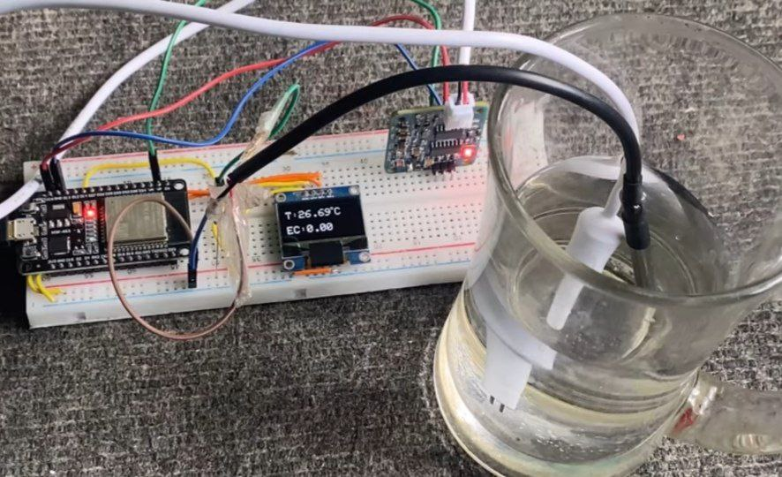

INTRODUCTION
Drinking Water
Quality Monitoring
System
Team Members :-
Yash Faujdar
Aditya Bansal
Sahil
Aman Yadav
Aditya Solanki
23SCSE1011264
23SCSE1010264
23SCSE1011256
23SCSE1011985
23SCSE1012096
Galgotias University
Btech CSE 1st year

Slide 2


Slide 3
Drinking Water Quality Monitoring System
IMPORTANCE
Access to clean and safe drinking water
is a fundamental human right.

Slide 4

Drinking Water Quality Monitoring System
IMPORTANCE
Access to clean and safe drinking water
is a fundamental human right.
PURPOSE
Today, we'll explore the challenges, technology, and impact of water quality monitoring.

Slide 5

Drinking Water Quality Monitoring System
CHALLENGES
Contaminated water can lead to severe health risks and diseases
Water can be contaminated with bacteria, heavy metals, chemicals, and more
Consuming unsafe water can result in diseases , such as typhoid and leads to poisoning.

Slide 6
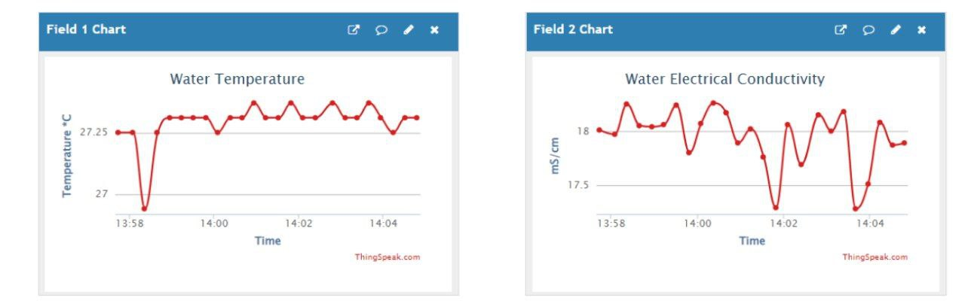
THE SOLUTION
The Drinking Water Quality Monitoring System
is the solution to these challenges
It continuously assesses
Water Quality to ensure
it meets safety standards

Slide 7
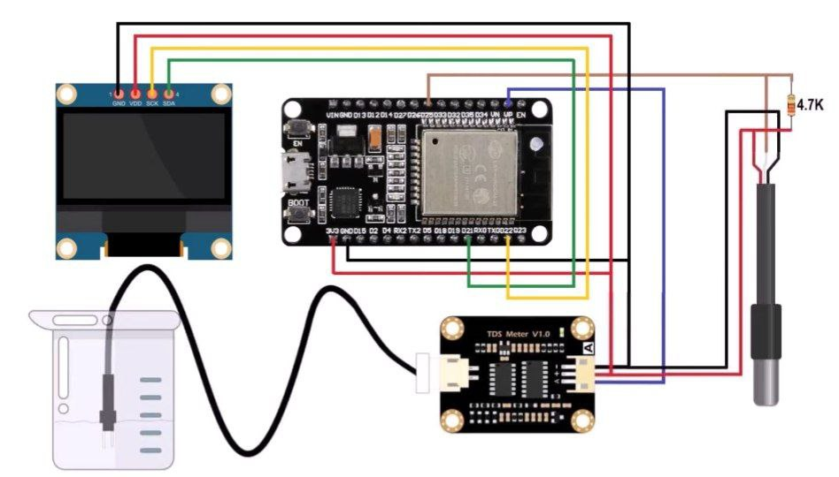
THE TECHNOLOGY
HARDWARE
SOFTWARE
Temperature Sensor
TDS Sensor
OLED Screen
Breadboard
Resistor
ESP32
Thingspeak Server

Slide 8
THE CONCLUSION
“Drinking Water Quality
Monitoring Systems
play a vital role in ensuring safe and clean
drinking water for all”

Slide 9
Drinking Water Quality Monitoring System
Thank You
For Your Attention
Now, we're open to any questions you may have.
Team Members :-
Yash Faujdar
Aditya Bansal
Sahil
Aman Yadav
Aditya Solanki
23SCSE1011264
23SCSE1010264
23SCSE1011256
23SCSE1011985
23SCSE1012096
Galgotias University
Btech CSE 1st year

